Slide 1

Capstone Project – The Battle of Neighborhoods

Slide 2
1. Introduction:
The purpose of this Capstone Project is to help people in exploring better facilities around their neighborhood
The main aim is to create an analysis of features for a people migrating to Scarborough to search a best neighborhood as a comparative analysis between neighborhoods
The features include median housing price and better school according to ratings, crime rates of that particular area, road connectivity, weather conditions, good management for emergency, water resources both freash and waste water and excrement conveyed in sewers and recreational facilities.
It will help people to get awareness of the area and neighborhood before moving to a new city, state, country or place for their work or to start a new fresh life.

Slide 3

Data Link: https://en.wikipedia.org/wiki/List_of_postal_codes_of_Canada:_M
Scarborough dataset which we scrapped from Wikipedia on Week 3.
Dataset consisting of latitude and longitude, zip codes.
2. Data Section
Foursquare API Data:
We will need data about different venues in different neighborhoods of that specific borough.

Slide 4
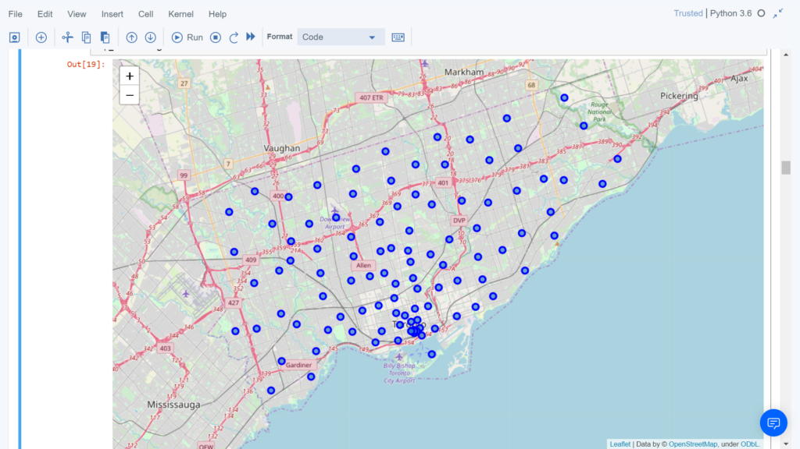
Map of Scarborough

Slide 5
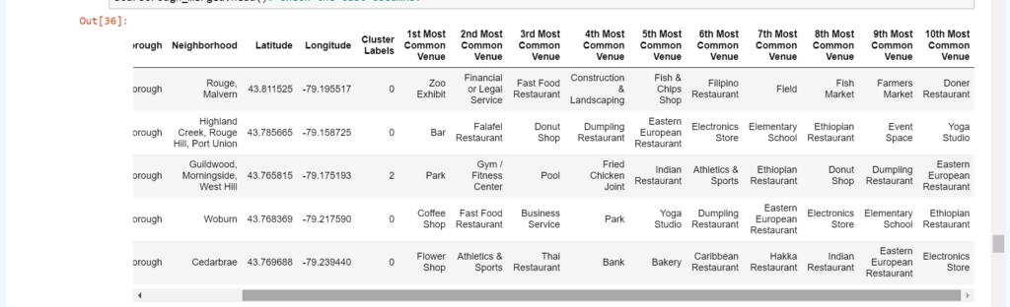
3. Methodology Section
K Means Clustering Approach:
To compare the similarities of two cities, we decided to explore neighborhoods, segment them,
and group them into clusters to find similar neighborhoods in a big city like New York and Toronto.
To be able to do that, we need to cluster data which is a form of unsupervised machine learning: k-means clustering algorithm.

Slide 6
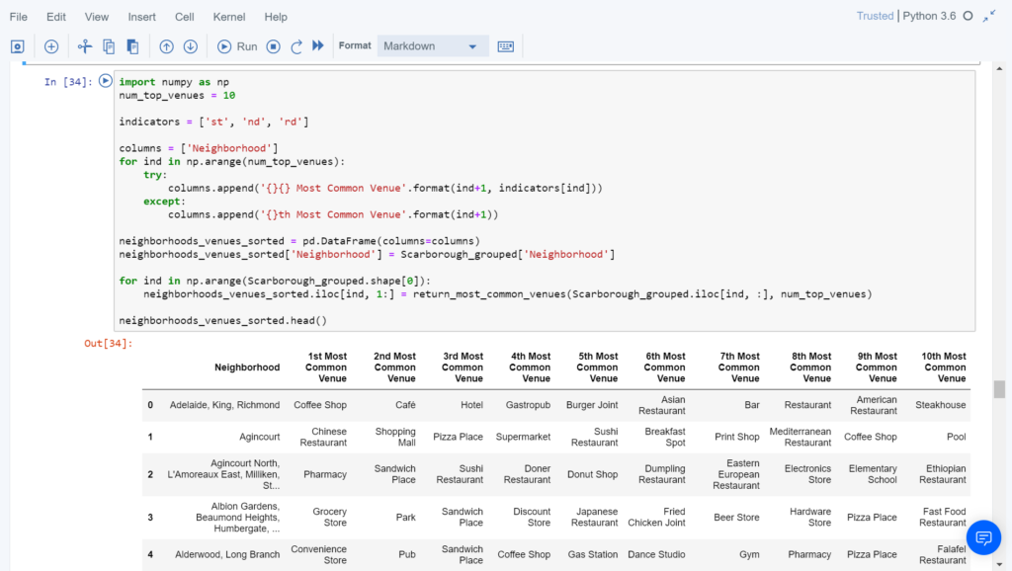
Most Common Venues near Neighborhood | Using Clustering

Slide 7
4. Results Section

Slide 8
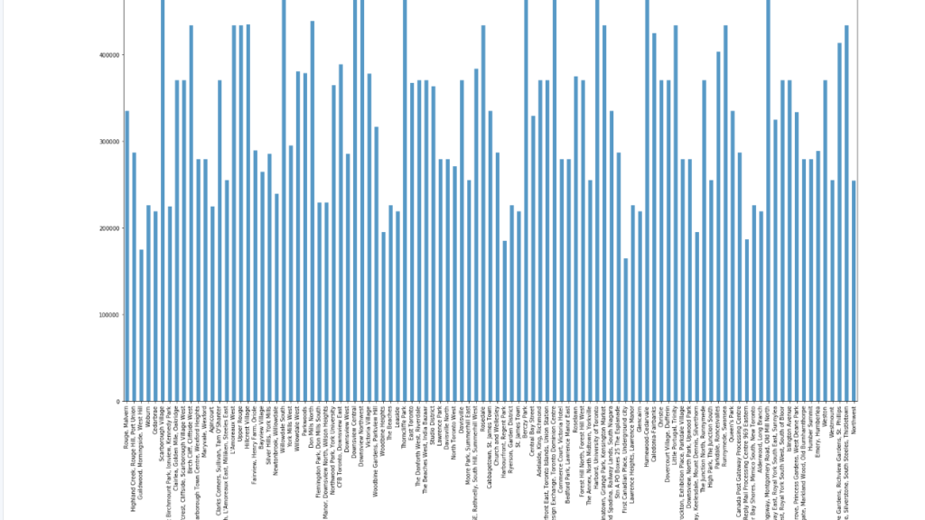
Average Housing Price by Clusters in Scarborough

Slide 9
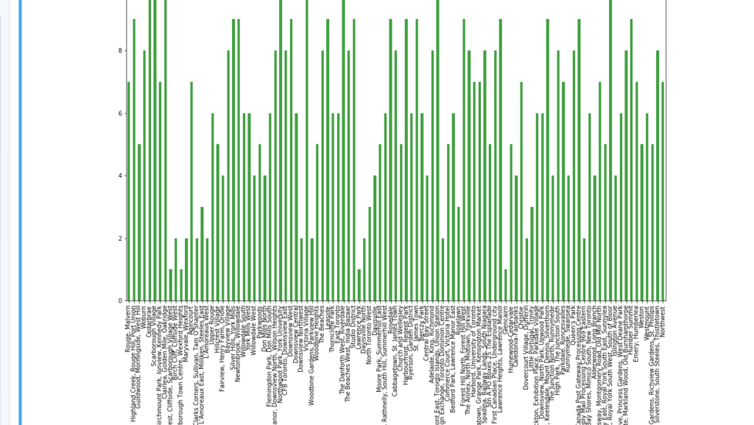
School Ratings by Clusters in Scarborough

Slide 10
In this Capstone project, using k-means cluster algorithm I separated the neighborhood into 10(Ten) different clusters and for 103 different lattitude and logitude from dataset, which have very-similar neighborhoods around them. Using the charts above results presented to a particular neighborhood based on average house prices and school rating have been made.
5. Conclusion

Slide 11
Appendix
Pandas: For creating and manipulating dataframes.
Folium: Python visualization library would be used to visualize the neighborhoods cluster distribution of using interactive leaflet map.
Scikit Learn: For importing k-means clustering.
JSON: Library to handle JSON files.
XML: To separate data from presentation and XML stores data in plain text format
Geocoder: To retrieve Location Data.
Beautiful Soup and Requests: To scrap and library to handle http requests
Matplotlib: Python Plotting Module.

